Slide 1
Introduction to DB design Entity-Relationship Model The Relational Model
DCIT 305
Matilda Wilson

Slide 2
Chapter Outline
Overview of Database Design Process
Example Database Application (COMPANY)
ER Model Concepts
Entities and Attributes
Entity Types, Value Sets, and Key Attributes
Relationships and Relationship Types
Weak Entity Types
Roles and Attributes in Relationship Types
ER Diagrams - Notation
ER Diagram for COMPANY Schema
Alternative Notations – UML class diagrams, others

Slide 3
Overview of Database Design Process
Two main activities:
Database design
Applications design
Focus in this course on database design
To design the conceptual schema for a database application
Applications design focuses on the programs and interfaces that access the database
Generally considered part of software engineering

Slide 4
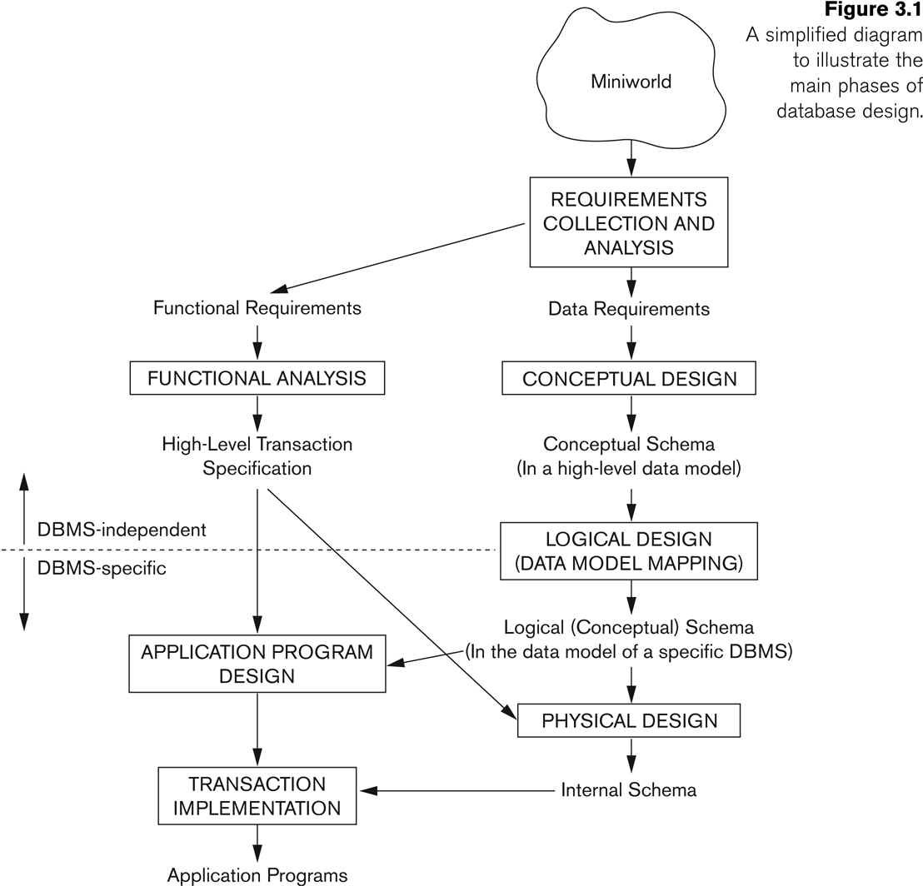
Overview of Database Design Process

Slide 5
Example COMPANY Database
We need to create a database schema design based on the following (simplified) requirements of the COMPANY Database:
The company is organized into DEPARTMENTs. Each department has a name, number and an employee who manages the department. We keep track of the start date of the department manager. A department may have several locations.
Each department controls a number of PROJECTs. Each project has a unique name, unique number and is located at a single location.

Slide 6
Example COMPANY Database (Contd.)
We store each EMPLOYEE’s social security number, address, salary, sex, and birthdate.
Each employee works for one department but may work on several projects.
We keep track of the number of hours per week that an employee currently works on each project.
We also keep track of the direct supervisor of each employee.
Each employee may have a number of DEPENDENTs.
For each dependent, we keep track of their name, sex, birthdate, and relationship to the employee.

Slide 7
ER Model Concepts
Entities and Attributes
Entities are specific objects or things in the mini-world that are represented in the database.
For example the EMPLOYEE John Smith, the Research DEPARTMENT, the ProductX PROJECT
Attributes are properties used to describe an entity.
For example an EMPLOYEE entity may have the attributes Name, SSN, Address, Sex, BirthDate
A specific entity will have a value for each of its attributes.
For example a specific employee entity may have Name='John Smith', SSN='123456789', Address ='731, Fondren, Houston, TX', Sex='M', BirthDate='09-JAN-55‘
Each attribute has a value set (or data type) associated with it – e.g. integer, string, subrange, enumerated type, …

Slide 8
Types of Attributes (1)
Simple
Each entity has a single atomic value for the attribute. For example, SSN or Sex.
Composite
The attribute may be composed of several components. For example:
Address(Apt#, House#, Street, City, State, ZipCode, Country), or
Name(FirstName, MiddleName, LastName).
Composition may form a hierarchy where some components are themselves composite.
Multi-valued
An entity may have multiple values for that attribute. For example, Color of a CAR or PreviousDegrees of a STUDENT.
Denoted as {Color} or {PreviousDegrees}.

Slide 9
Types of Attributes (2)
In general, composite and multi-valued attributes may be nested arbitrarily to any number of levels, although this is rare.
For example, PreviousDegrees of a STUDENT is a composite multi-valued attribute denoted by {PreviousDegrees (College, Year, Degree, Field)}
Multiple PreviousDegrees values can exist
Each has four subcomponent attributes:
College, Year, Degree, Field

Slide 10
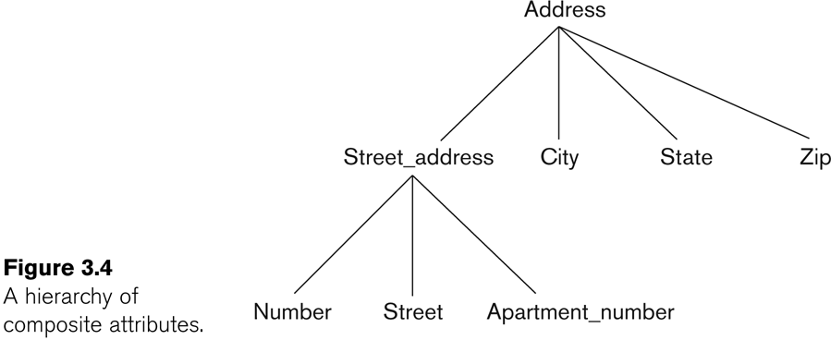
Example of a composite attribute

Slide 11
Entity Types and Key Attributes (1)
Entities with the same basic attributes are grouped or typed into an entity type.
For example, the entity type EMPLOYEE and PROJECT.
An attribute of an entity type for which each entity must have a unique value is called a key attribute of the entity type.
For example, SSN of EMPLOYEE.

Slide 12
Entity Types and Key Attributes (2)
A key attribute may be composite.
VehicleTagNumber is a key of the CAR entity type with components (Number, Year).
An entity type may have more than one key.
The CAR entity type may have two keys:
VehicleIdentificationNumber (popularly called VIN)
VehicleTagNumber (Number, Year), aka license plate number.
Each key is underlined

Slide 13
Displaying an Entity type
In ER diagrams, an entity type is displayed in a rectangular box
Attributes are displayed in ovals
Each attribute is connected to its entity type
Components of a composite attribute are connected to the oval representing the composite attribute
Each key attribute is underlined
Multivalued attributes displayed in double ovals
See CAR example on next slide

Slide 14
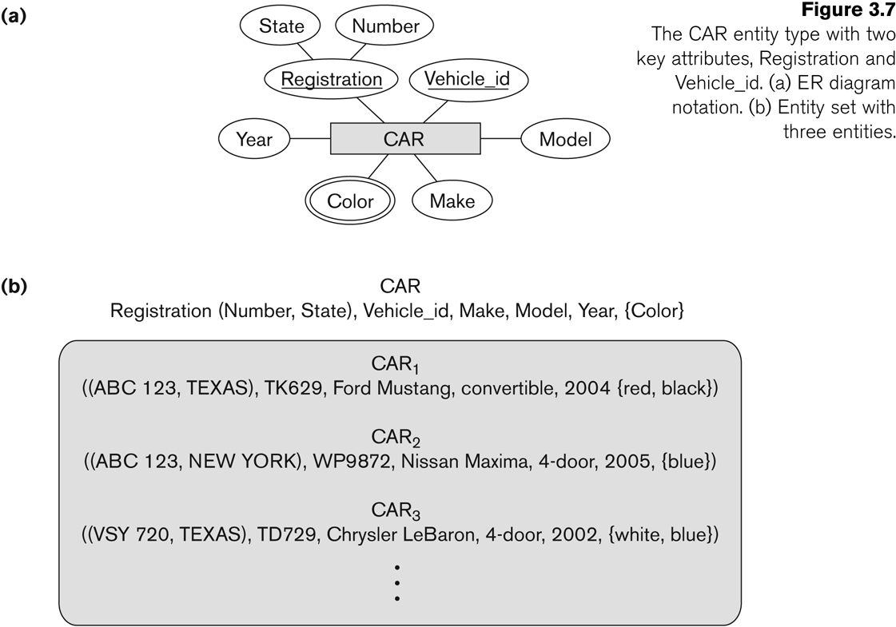
Entity Type CAR with two keys and a corresponding Entity Set

Slide 15
Entity Set
Each entity type will have a collection of entities stored in the database
Called the entity set
Previous slide shows three CAR entity instances in the entity set for CAR
Same name (CAR) used to refer to both the entity type and the entity set
Entity set is the current state of the entities of that type that are stored in the database

Slide 16
Initial Design of Entity Types for the COMPANY Database Schema
Based on the requirements, we can identify four initial entity types in the COMPANY database:
DEPARTMENT
PROJECT
EMPLOYEE
DEPENDENT
Their initial design is shown on the following slide
The initial attributes shown are derived from the requirements description

Slide 17
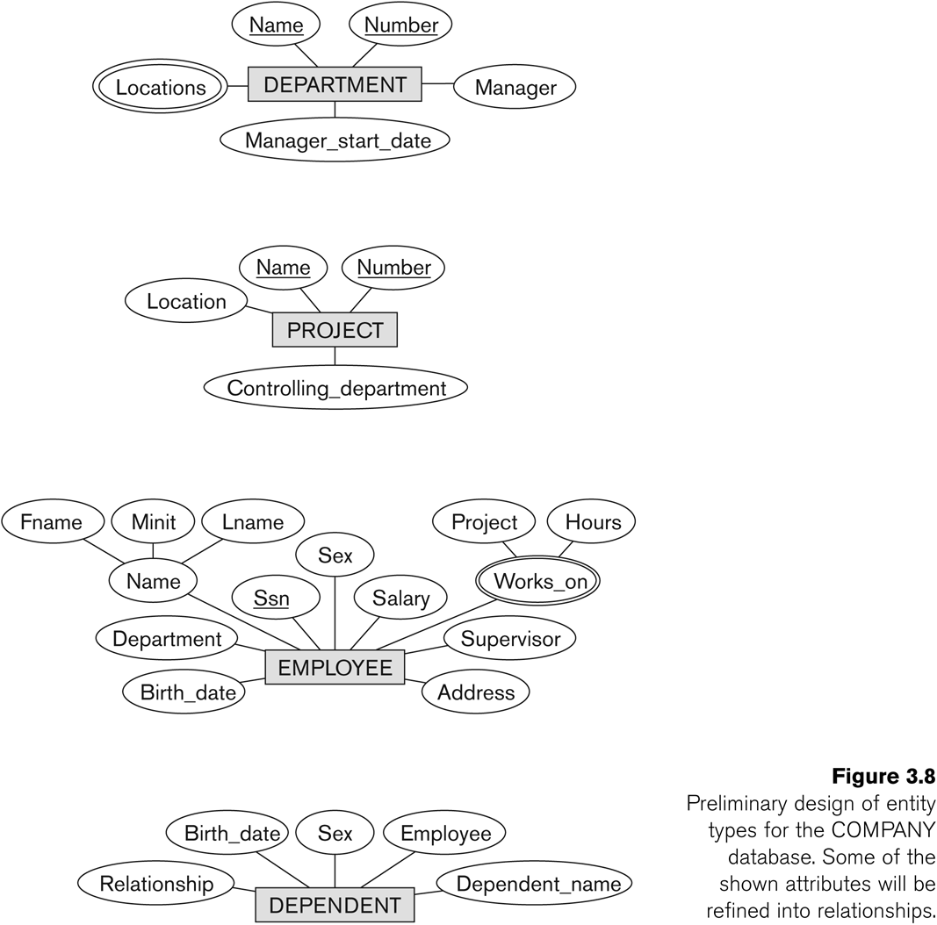
Initial Design of Entity Types: EMPLOYEE, DEPARTMENT, PROJECT, DEPENDENT

Slide 18
Refining the initial design by introducing relationships
The initial design is typically not complete
Some aspects in the requirements will be represented as relationships
ER model has three main concepts:
Entities (and their entity types and entity sets)
Attributes (simple, composite, multivalued)
Relationships (and their relationship types and relationship sets)
We introduce relationship concepts next

Slide 19
Relationships and Relationship Types (1)
A relationship relates two or more distinct entities with a specific meaning.
For example, EMPLOYEE John Smith works on the ProductX PROJECT, or EMPLOYEE Franklin Wong manages the Research DEPARTMENT.
Relationships of the same type are grouped or typed into a relationship type.
For example, the WORKS_ON relationship type in which EMPLOYEEs and PROJECTs participate, or the MANAGES relationship type in which EMPLOYEEs and DEPARTMENTs participate.
The degree of a relationship type is the number of participating entity types.
Both MANAGES and WORKS_ON are binary relationships.

Slide 20
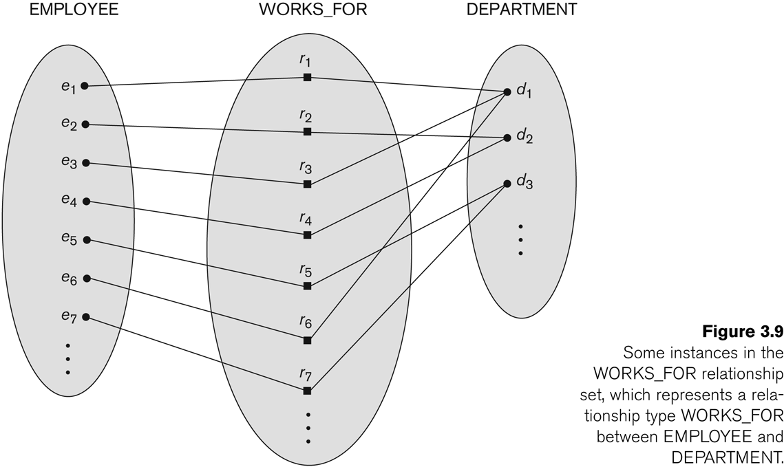
Relationship instances of the WORKS_FOR N:1 relationship between EMPLOYEE and DEPARTMENT

Slide 21
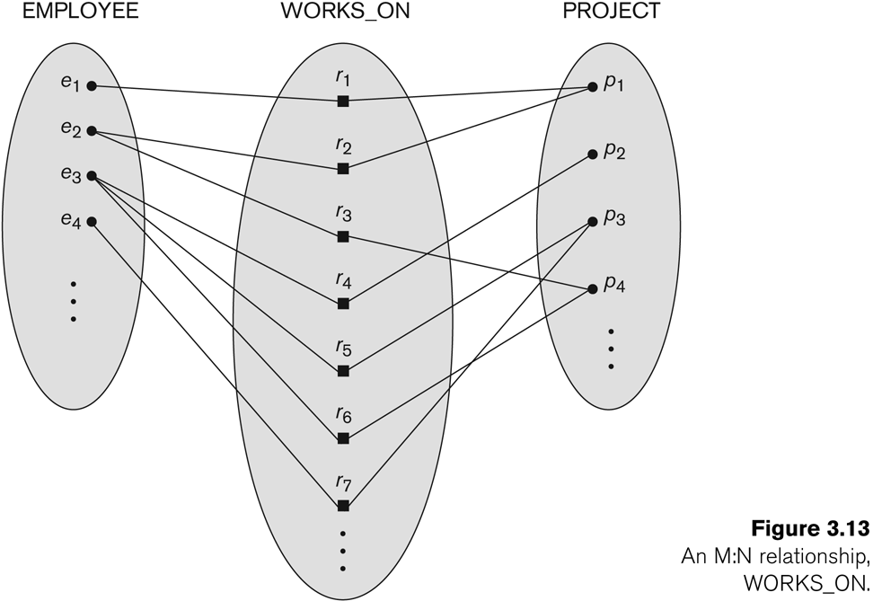
Relationship instances of the M:N WORKS_ON relationship between EMPLOYEE and PROJECT

Slide 22
Relationship type vs. relationship set (1)
Relationship Type:
Is the schema description of a relationship
Identifies the relationship name and the participating entity types
Also identifies certain relationship constraints
Relationship Set:
The current set of relationship instances represented in the database
The current state of a relationship type

Slide 23
Relationship type vs. relationship set (2)
Previous figures displayed the relationship sets
Each instance in the set relates individual participating entities – one from each participating entity type
In ER diagrams, we represent the relationship type as follows:
Diamond-shaped box is used to display a relationship type
Connected to the participating entity types via straight lines

Slide 24
Refining the COMPANY database schema by introducing relationships
By examining the requirements, six relationship types are identified
All are binary relationships( degree 2)
Listed below with their participating entity types:
WORKS_FOR (between EMPLOYEE, DEPARTMENT)
MANAGES (also between EMPLOYEE, DEPARTMENT)
CONTROLS (between DEPARTMENT, PROJECT)
WORKS_ON (between EMPLOYEE, PROJECT)
SUPERVISION (between EMPLOYEE (as subordinate), EMPLOYEE (as supervisor))
DEPENDENTS_OF (between EMPLOYEE, DEPENDENT)

Slide 25
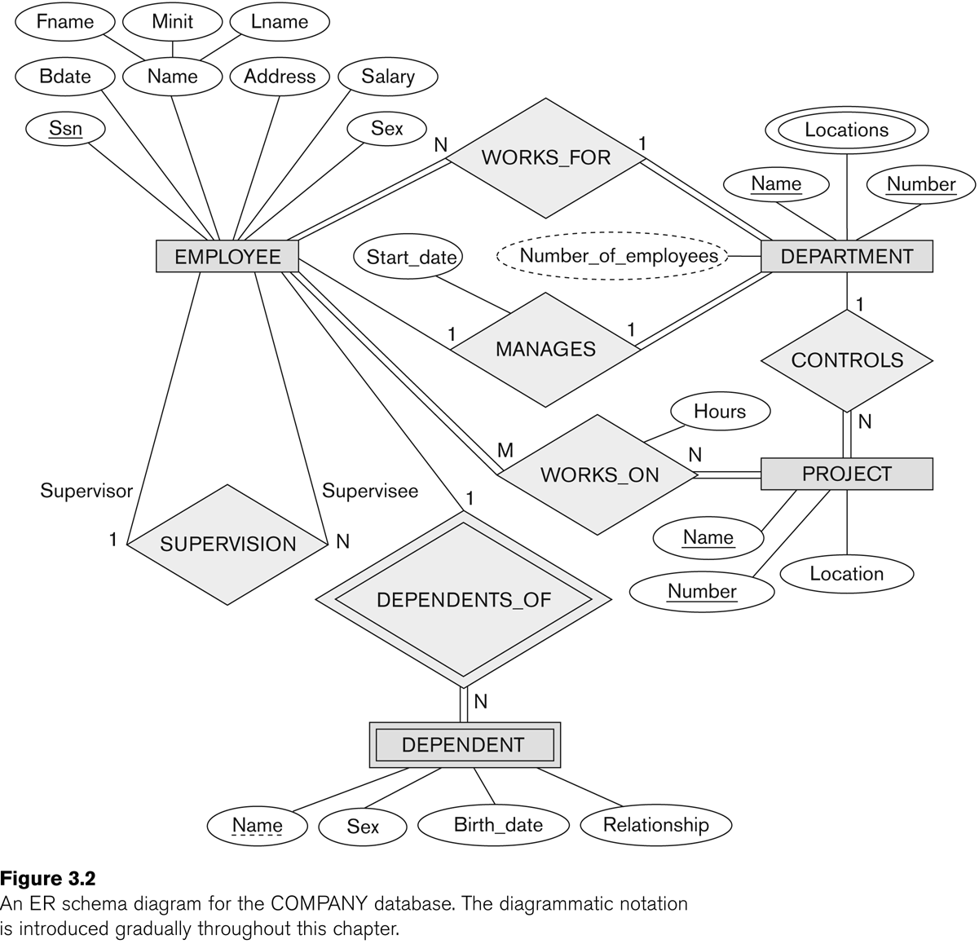
ER DIAGRAM – Relationship Types are: WORKS_FOR, MANAGES, WORKS_ON, CONTROLS, SUPERVISION, DEPENDENTS_OF

Slide 26
Discussion on Relationship Types
In the refined design, some attributes from the initial entity types are refined into relationships:
Manager of DEPARTMENT -> MANAGES
Works_on of EMPLOYEE -> WORKS_ON
Department of EMPLOYEE -> WORKS_FOR
etc
In general, more than one relationship type can exist between the same participating entity types
MANAGES and WORKS_FOR are distinct relationship types between EMPLOYEE and DEPARTMENT
Different meanings and different relationship instances.

Slide 27
Recursive Relationship Type
A relationship type whose with the same participating entity type in distinct roles
Example: the SUPERVISION relationship
EMPLOYEE participates twice in two distinct roles:
supervisor (or boss) role
supervisee (or subordinate) role
Each relationship instance relates two distinct EMPLOYEE entities:
One employee in supervisor role
One employee in supervisee role

Slide 28
Weak Entity Types
An entity that does not have a key attribute
A weak entity must participate in an identifying relationship type with an owner or identifying entity type
Entities are identified by the combination of:
A partial key of the weak entity type
The particular entity they are related to in the identifying entity type
Example:
A DEPENDENT entity is identified by the dependent’s first name, and the specific EMPLOYEE with whom the dependent is related
Name of DEPENDENT is the partial key
DEPENDENT is a weak entity type
EMPLOYEE is its identifying entity type via the identifying relationship type DEPENDENT_OF

Slide 29
Constraints on Relationships
Constraints on Relationship Types
(Also known as ratio constraints)
Cardinality Ratio (specifies maximum participation)
One-to-one (1:1)
One-to-many (1:N) or Many-to-one (N:1)
Many-to-many (M:N)
Existence Dependency Constraint (specifies minimum participation) (also called participation constraint)
zero (optional participation, not existence-dependent)
one or more (mandatory participation, existence-dependent)

Slide 30
Many-to-one (N:1) Relationship

Slide 31
Many-to-many (M:N) Relationship

Slide 32
Displaying a recursive relationship
In a recursive relationship type.
Both participations are same entity type in different roles.
For example, SUPERVISION relationships between EMPLOYEE (in role of supervisor or boss) and (another) EMPLOYEE (in role of subordinate or worker).
In following figure, first role participation labeled with 1 and second role participation labeled with 2.
In ER diagram, need to display role names to distinguish participations.

Slide 33
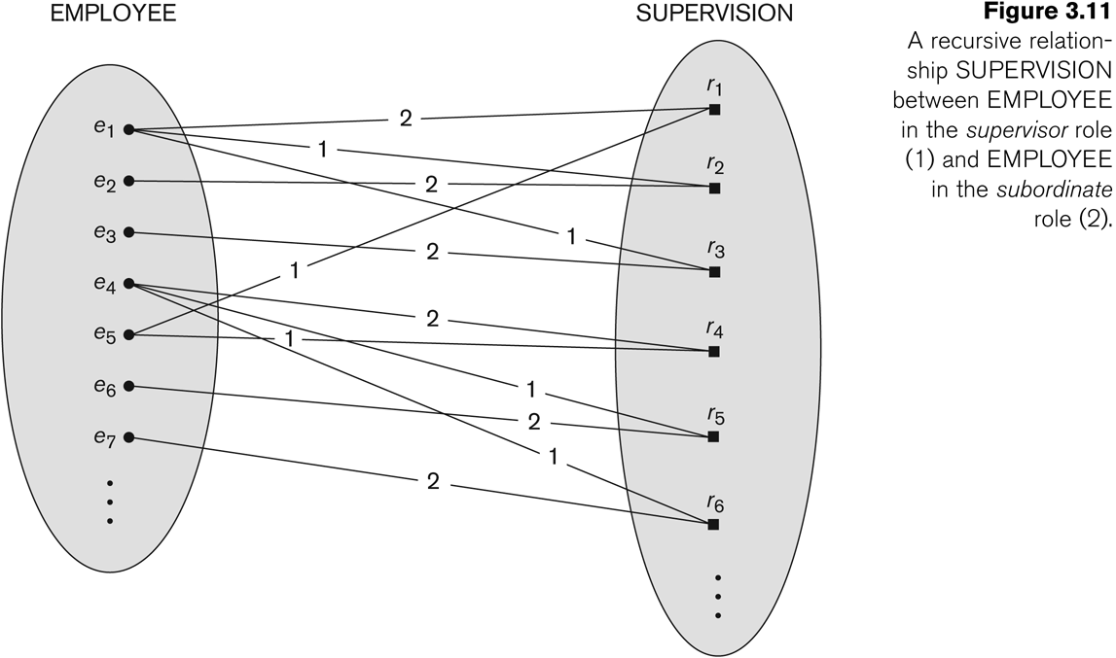
A Recursive Relationship Supervision`

Slide 34
Recursive Relationship Type is: SUPERVISION (participation role names are shown)

Slide 35
Attributes of Relationship types
A relationship type can have attributes:
For example, HoursPerWeek of WORKS_ON
Its value for each relationship instance describes the number of hours per week that an EMPLOYEE works on a PROJECT.
A value of HoursPerWeek depends on a particular (employee, project) combination
Most relationship attributes are used with M:N relationships
In 1:N relationships, they can be transferred to the entity type on the N-side of the relationship

Slide 36
Example Attribute of a Relationship Type: Hours of WORKS_ON

Slide 37
Notation for Constraints on Relationships
Cardinality ratio (of a binary relationship): 1:1, 1:N, N:1, or M:N
Shown by placing appropriate numbers on the relationship edges.
Participation constraint (on each participating entity type): total (called existence dependency) or partial.
Total shown by double line, partial by single line.
NOTE: These are easy to specify for Binary Relationship Types.

Slide 38
Alternative (min, max) notation for relationship structural constraints:
Specified on each participation of an entity type E in a relationship type R
Specifies that each entity e in E participates in at least min and at most max relationship instances in R
Default(no constraint): min=0, max=n (signifying no limit)
Must have min≤max, min≥0, max ≥1
Derived from the knowledge of mini-world constraints
Examples:
A department has exactly one manager and an employee can manage at most one department.
Specify (0,1) for participation of EMPLOYEE in MANAGES
Specify (1,1) for participation of DEPARTMENT in MANAGES
An employee can work for exactly one department but a department can have any number of employees.
Specify (1,1) for participation of EMPLOYEE in WORKS_FOR
Specify (0,n) for participation of DEPARTMENT in WORKS_FOR

Slide 39
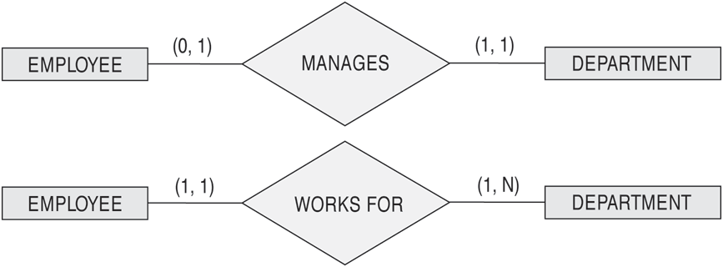

The (min,max) notation for relationship constraints
Read the min,max numbers next to the entity type and looking away from the entity type

Slide 40
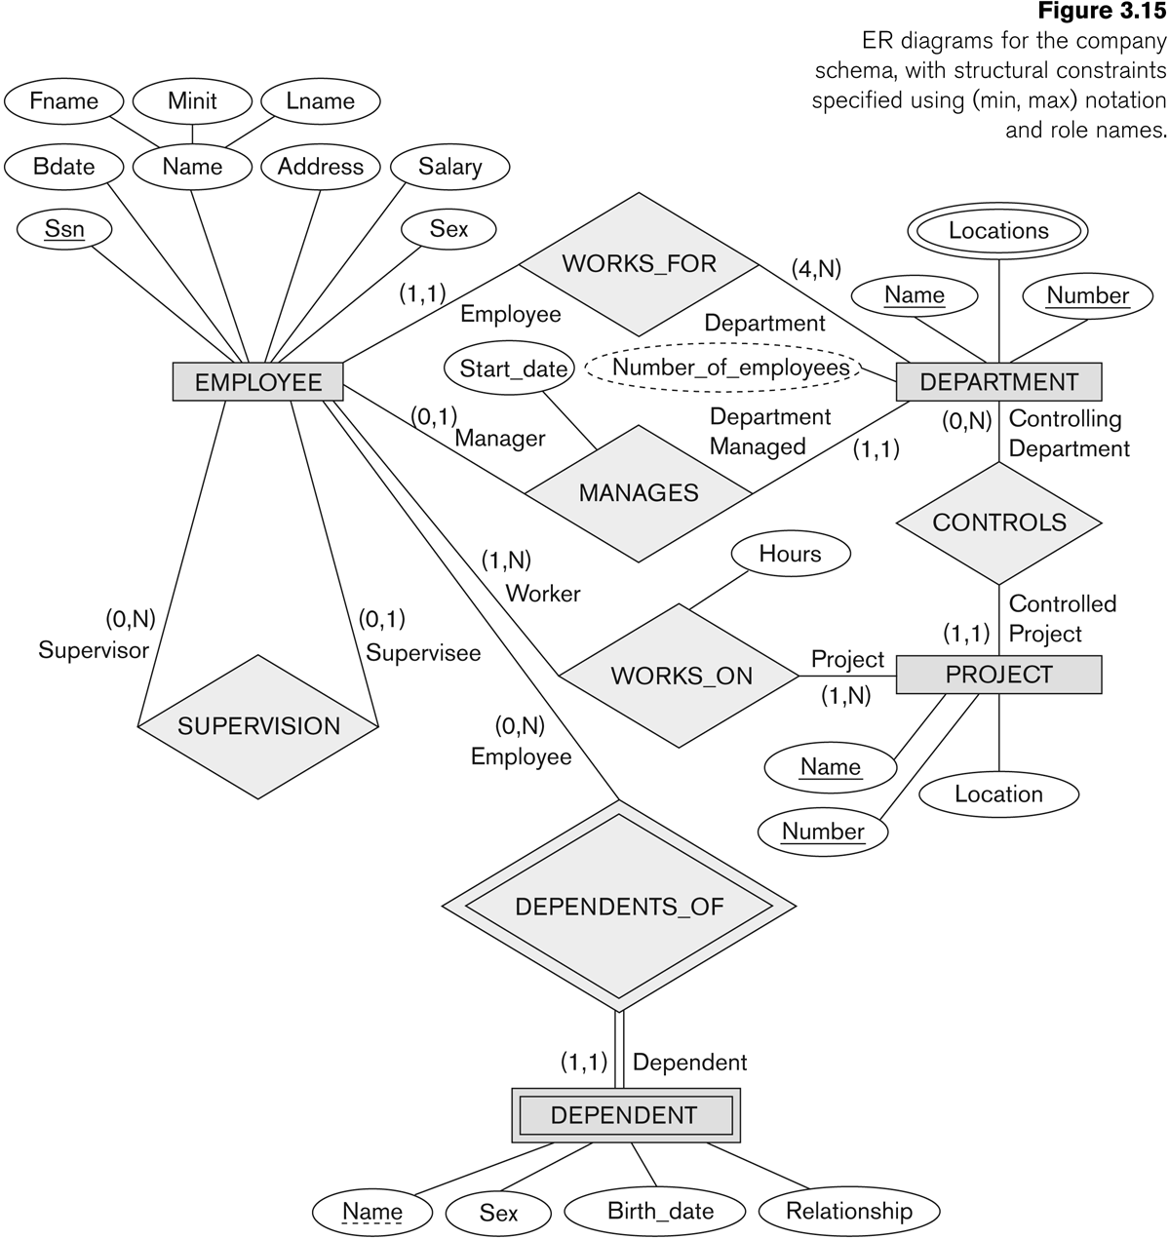
COMPANY ER Schema Diagram using (min, max) notation

Slide 41
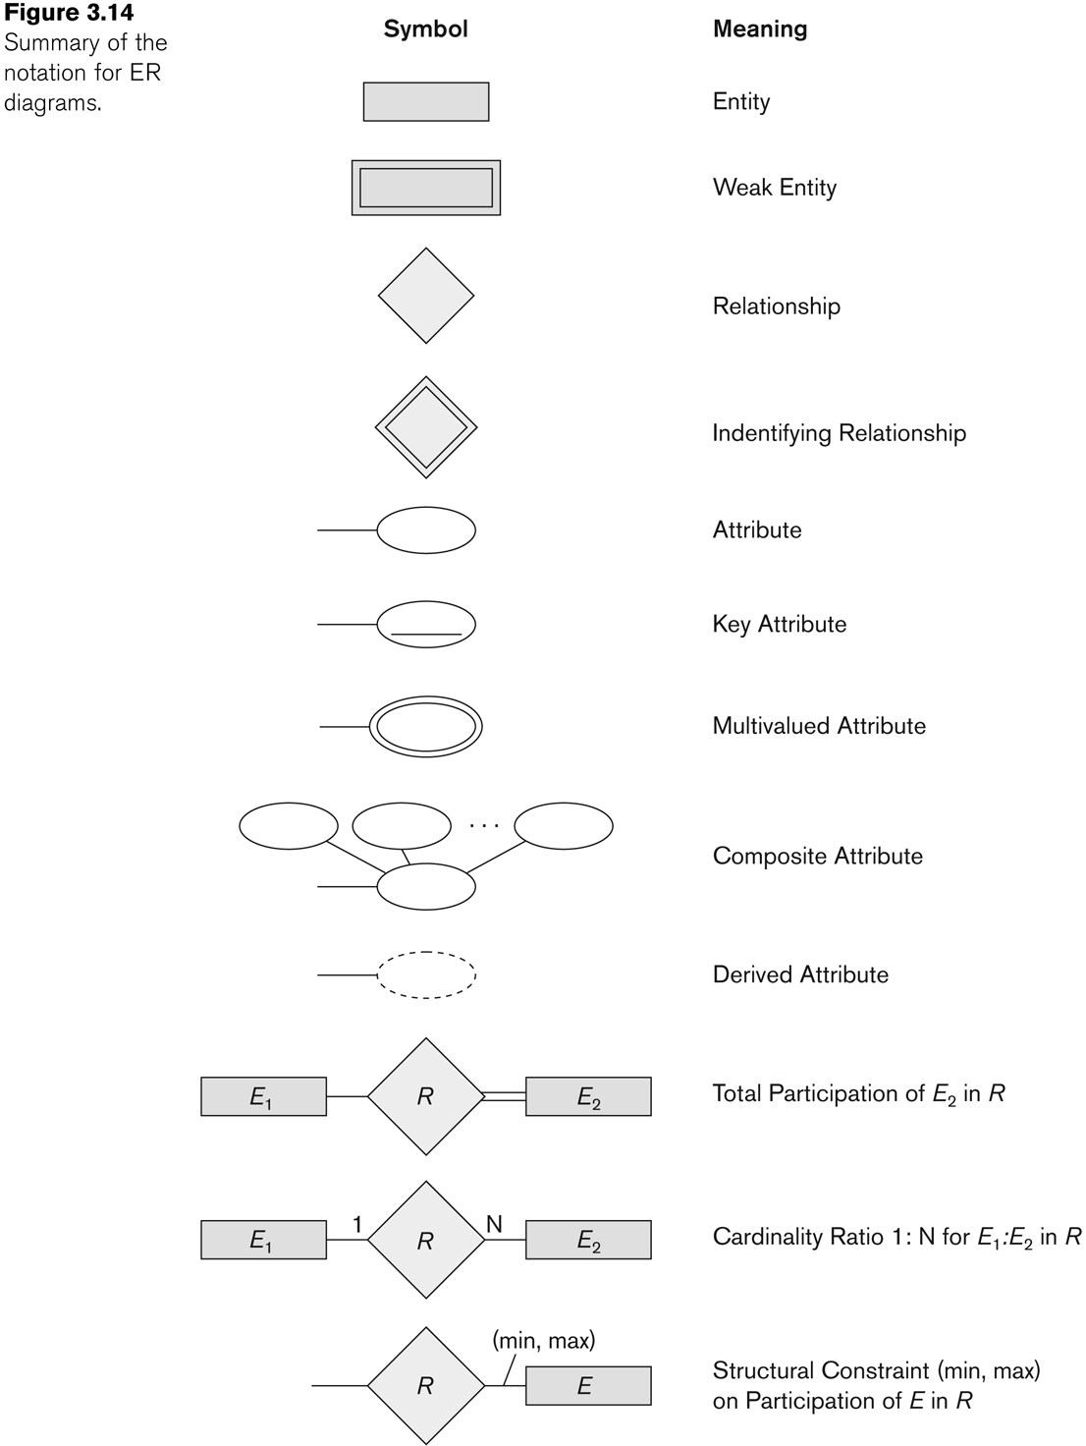
Summary of notation for ER diagrams

Slide 42
Relationships of Higher Degree
Relationship types of degree 2 are called binary
Relationship types of degree 3 are called ternary and of degree n are called n-ary
In general, an n-ary relationship is not equivalent to n binary relationships
Constraints are harder to specify for higher-degree relationships (n > 2) than for binary relationships

Slide 43
Discussion of n-ary relationships (n > 2)
In general, 3 binary relationships can represent different information than a single ternary relationship (see Figure 3.17a and b on next slide)
If needed, the binary and n-ary relationships can all be included in the schema design (see Figure 3.17a and b, where all relationships convey different meanings)
In some cases, a ternary relationship can be represented as a weak entity if the data model allows a weak entity type to have multiple identifying relationships (and hence multiple owner entity types) (see Figure 3.17c)

Slide 44
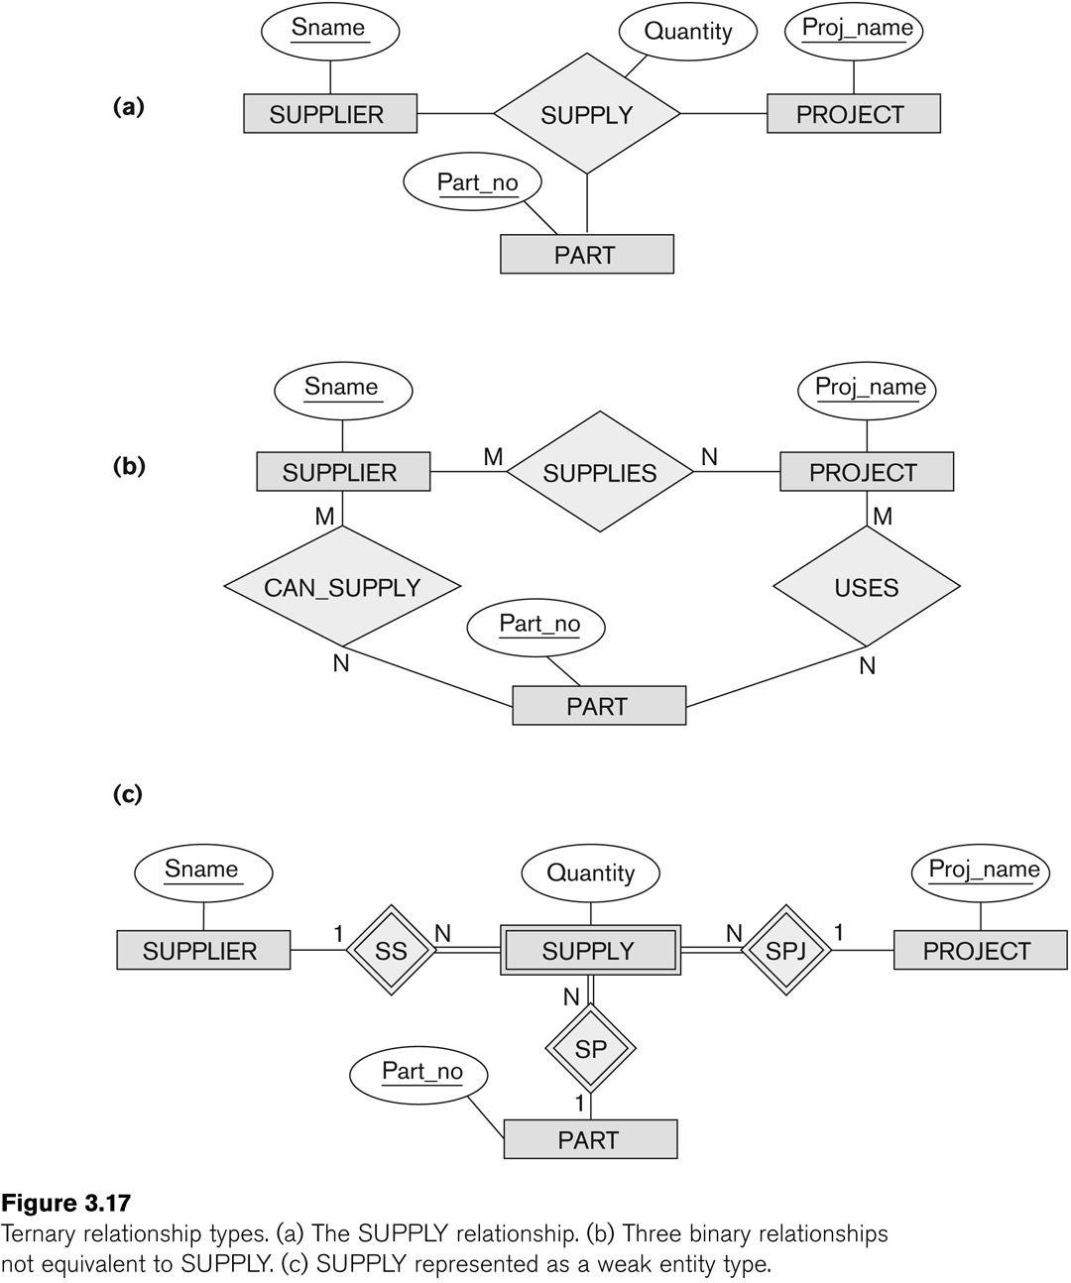
Example of a ternary relationship

Slide 45
Discussion of n-ary relationships (n > 2)
If a particular binary relationship can be derived from a higher-degree relationship at all times, then it is redundant
For example, the TAUGHT_DURING binary relationship in Figure 3.18 (see next slide) can be derived from the ternary relationship OFFERS (based on the meaning of the relationships)

Slide 46
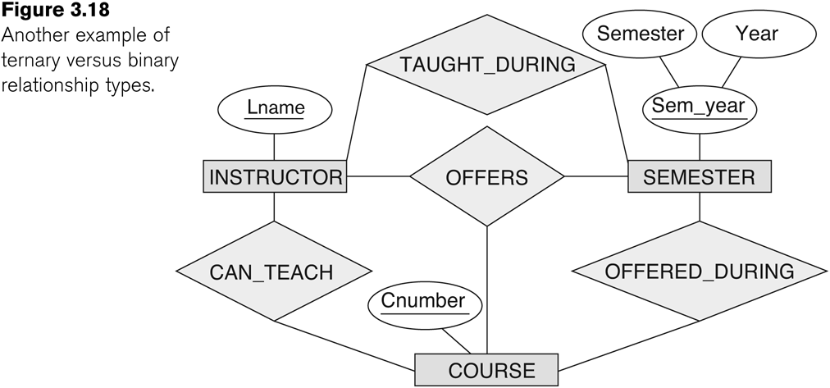
Another example of a ternary relationship

Slide 47
Displaying constraints on higher-degree relationships
The (min, max) constraints can be displayed on the edges – however, they do not fully describe the constraints
Displaying a 1, M, or N indicates additional constraints
An M or N indicates no constraint
A 1 indicates that an entity can participate in at most one relationship instance that has a particular combination of the other participating entities
In general, both (min, max) and 1, M, or N are needed to describe fully the constraints

Slide 48
Data Modeling Tools
A number of popular tools that cover conceptual modeling and mapping into relational schema design.
Examples: ERWin, S- Designer (Enterprise Application Suite), ER- Studio, etc.
POSITIVES:
Serves as documentation of application requirements, easy user interface - mostly graphics editor support
NEGATIVES:
Most tools lack a proper distinct notation for relationships with relationship attributes
Mostly represent a relational design in a diagrammatic form rather than a conceptual ER-based design
(See Chapter 12 for details)

Slide 49
Some of the Currently Available Automated Database Design Tools
COMPANY | TOOL | FUNCTIONALITY
Embarcadero Technologies | ER Studio | Database Modeling in ER and IDEF1X
 | DB Artisan | Database administration, space and security management
Oracle | Developer 2000/Designer 2000 | Database modeling, application development
Popkin Software | System Architect 2001 | Data modeling, object modeling, process modeling, structured analysis/design
Platinum (Computer Associates) | Enterprise Modeling Suite: Erwin, BPWin, Paradigm Plus | Data, process, and business component modeling
Persistence Inc. | Pwertier | Mapping from O-O to relational model
Rational (IBM) | Rational Rose | UML Modeling & application generation in C++/JAVA
Resolution Ltd. | Xcase | Conceptual modeling up to code maintenance
Sybase | Enterprise Application Suite | Data modeling, business logic modeling
Visio | Visio Enterprise | Data modeling, design/reengineering Visual Basic/C++

Slide 50
Extended Entity-Relationship (EER)
The entity relationship model in its original form did not support the specialization and generalization abstractions
Next slides illustrates how the ER model can be extended with
Type-subtype and set-subset relationships
Specialization/Generalization Hierarchies
Notation to display them in EER diagrams

Slide 51
Summary
ER Model Concepts: Entities, attributes, relationships
Constraints in the ER model
Using ER in step-by-step conceptual schema design for the COMPANY database
ER Diagrams - Notation

Slide 52
Entity Integrity: Selecting Primary Keys
Primary key is the most important characteristic of an entity
Single attribute or some combination of attributes
Primary keys and foreign keys work together to implement relationships
Properly selecting primary key has direct bearing on efficiency and effectiveness

Slide 53
Natural Keys and Primary Keys
Natural key is a real-world identifier used to uniquely identify real-world objects
Familiar to end users and forms part of their day-to-day business vocabulary
Generally, data modeler uses natural identifier as primary key of entity being modeled
May instead use composite primary key or surrogate key
Surrogate key - a PK created to simplify the identification of entity instances
Has no meaning, exists only to distinguish one entity from another (e.g., Autonumber)

Slide 54
Primary Key Guidelines
Attribute that uniquely identifies entity instances in an entity set
Could also be combination of attributes
Main function is to uniquely identify an entity instance or row within a table
Guarantee entity integrity, not to “describe” the entity
Primary keys and foreign keys implement relationships among entities
Behind the scenes, hidden from user

Slide 55
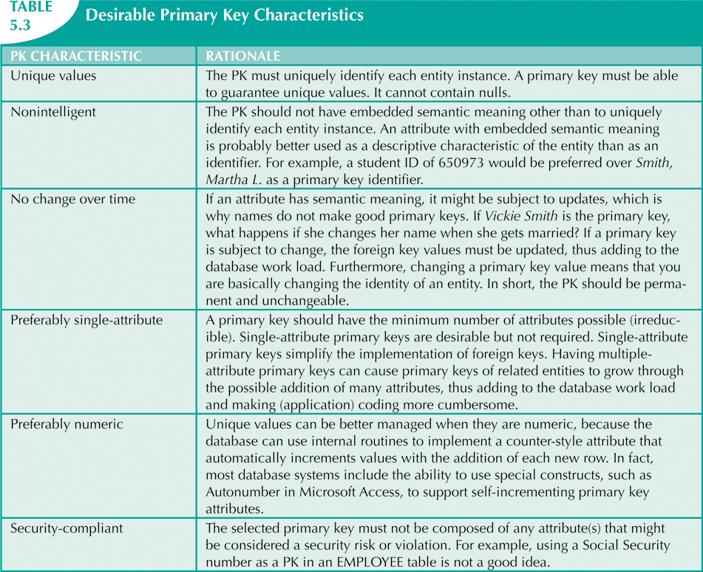

Slide 56
When to Use Composite Primary Keys
Composite primary keys useful in two cases:
As identifiers of composite entities
In which each primary key combination is allowed once in M:N relationship
As identifiers of weak entities
In which weak entity has a strong identifying relationship with the parent entity
Automatically provides benefit of ensuring that there cannot be duplicate values

Slide 57
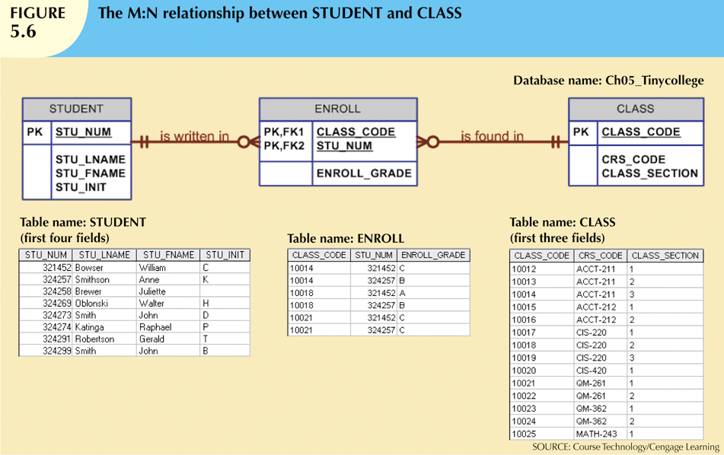
Composite PK of ENROLL ensures a student can not register for the same class twice

Slide 58
When to Use Composite Primary Keys
When used as identifiers of weak entities normally used to represent:
Real-world object that is existent-dependent on another real-world object
Real-world object that is represented in data model as two separate entities in strong identifying relationship
Dependent entity exists only when it is related to parent entity
EMPLOYEE and DEPENDENT – latter uses a composite PK containing employee id
LINE exists only as part of INVOICE

Slide 59
When To Use Surrogate Primary Keys
Especially helpful when there is:
No natural key
Selected candidate key has embedded semantic contents
Selected candidate key is too long or cumbersome

Slide 60
When To Use Surrogate Primary Keys
If you use surrogate key:
Ensure that candidate key of entity in question performs properly
Use “unique index” and “not null” constraints

Slide 61
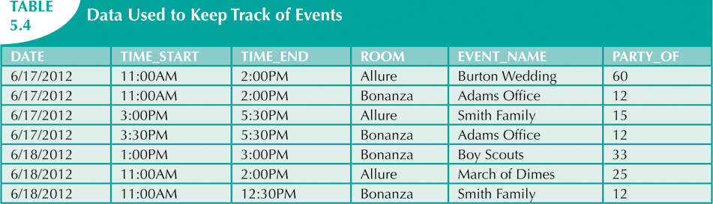
When To Use Surrogate Primary Keys
A catering hall has a number of rooms it rents for small parties
What should be the PK? DATE,TIME_START,ROOM
What if, in addition to the room, additional equipment were to be used from the RESOUCE table
Composite key for linking table would be DATE,TIME_START,ROOM, RSC_ID
Quite lengthy
If that became FK in another entity, it would be quite complex to maintain
Instead use numeric, single attribute surrogate key

Slide 62
Design Cases: Learning Flexible Database Design
Data modeling and design requires skills acquired through experience
Experience acquired through practice
Four special design cases that highlight:
Importance of flexible design
Proper identification of primary keys
Placement of foreign keys

Slide 63
Design Case 1: Implementing 1:1 Relationships
Foreign keys work with primary keys to properly implement relationships in relational model
Put primary key of the “one” side on the “many” side as foreign key
Primary key: parent entity
Foreign key: dependent entity

Slide 64
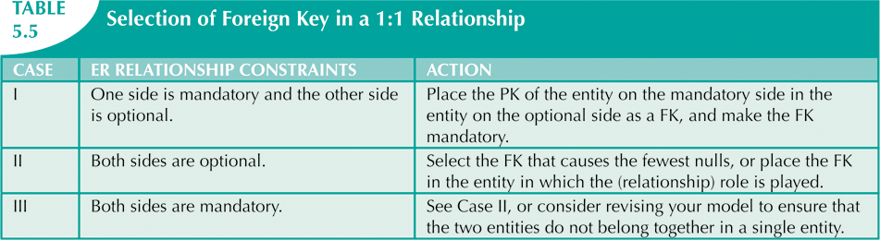
Design Case 1: Implementing 1:1 Relationships
In 1:1 relationship, there are two options:
Place a foreign key in both entities (not recommended)
Place a foreign key in one of the entities
Primary key of one of the two entities appears as foreign key of other

Slide 65
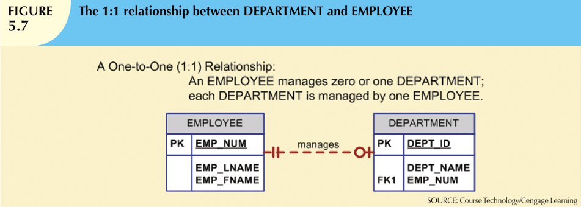

Slide 66
Design Case 2: Maintaining History of Time-Variant Data
Normally, existing attribute values are replaced with new value without regard to previous value
Time-variant data:
Values change over time
Must keep a history of data changes
Keeping history of time-variant data equivalent to having a multivalued attribute in your entity
Must create new entity in 1:M relationships with original entity
New entity contains new value, date of change

Slide 67
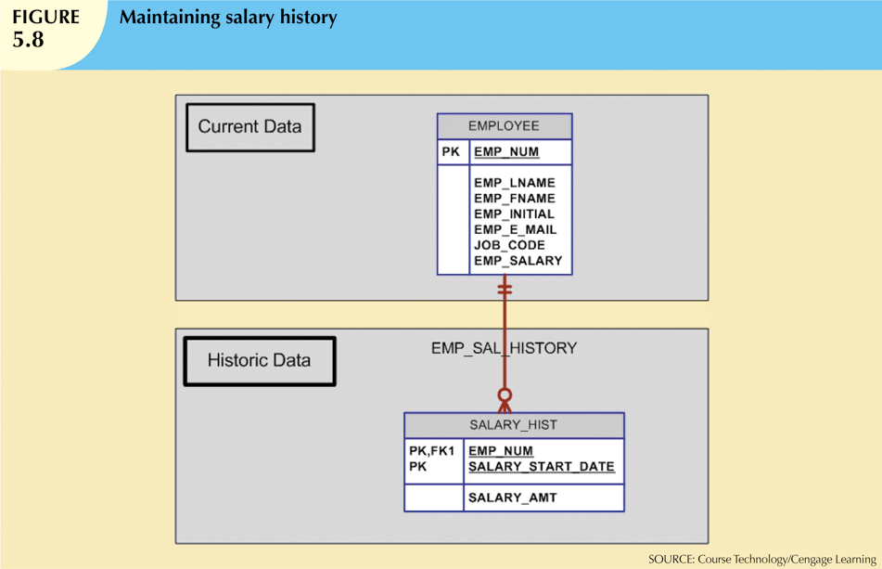

Slide 68
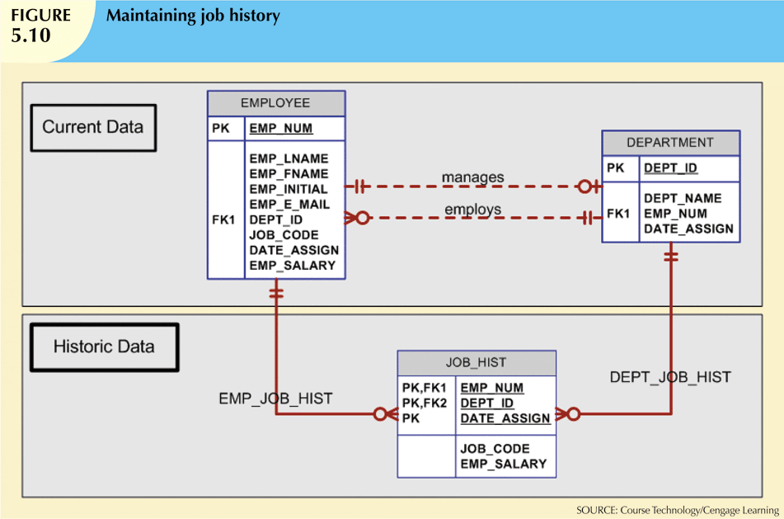

Slide 69
Design Case 3: Fan Traps
Design trap occurs when relationship is improperly or incompletely identified
Represented in a way not consistent with the real world
Most common design trap is known as fan trap
Fan trap occurs when one entity is in two 1:M relationships to other entities
Produces an association among other entities not expressed in the model

Slide 70
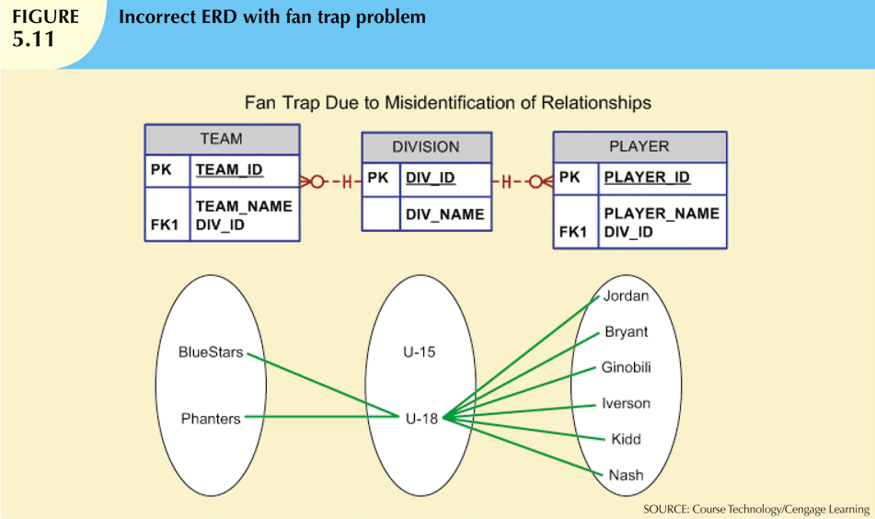

Slide 71
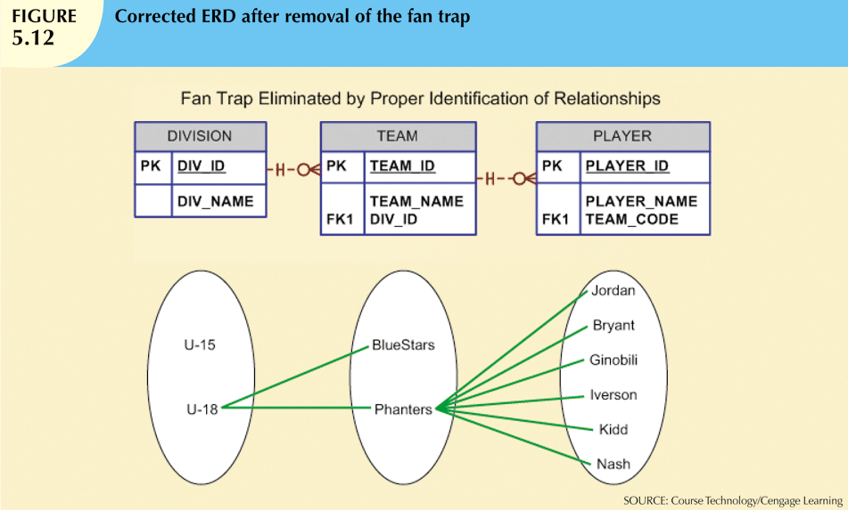

Slide 72
Design Case 4: Redundant Relationships
Redundancy is seldom a good thing in database environment
Occurs when there are multiple relationship paths between related entities
Main concern is that redundant relationships remain consistent across model
Some designs use redundant relationships to simplify the design
In the following example, the relationship between DIVISION and PLAYER is not needed as all information can be obtained through TEAM

Slide 73
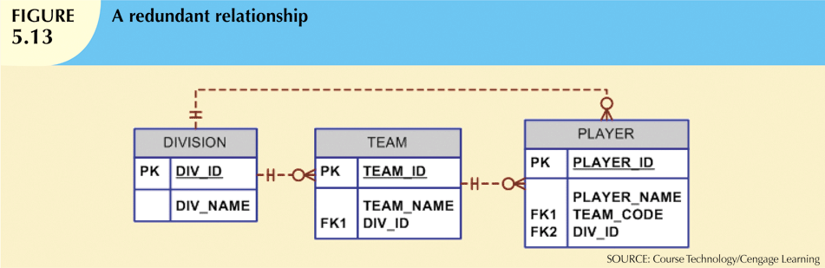

Slide 74
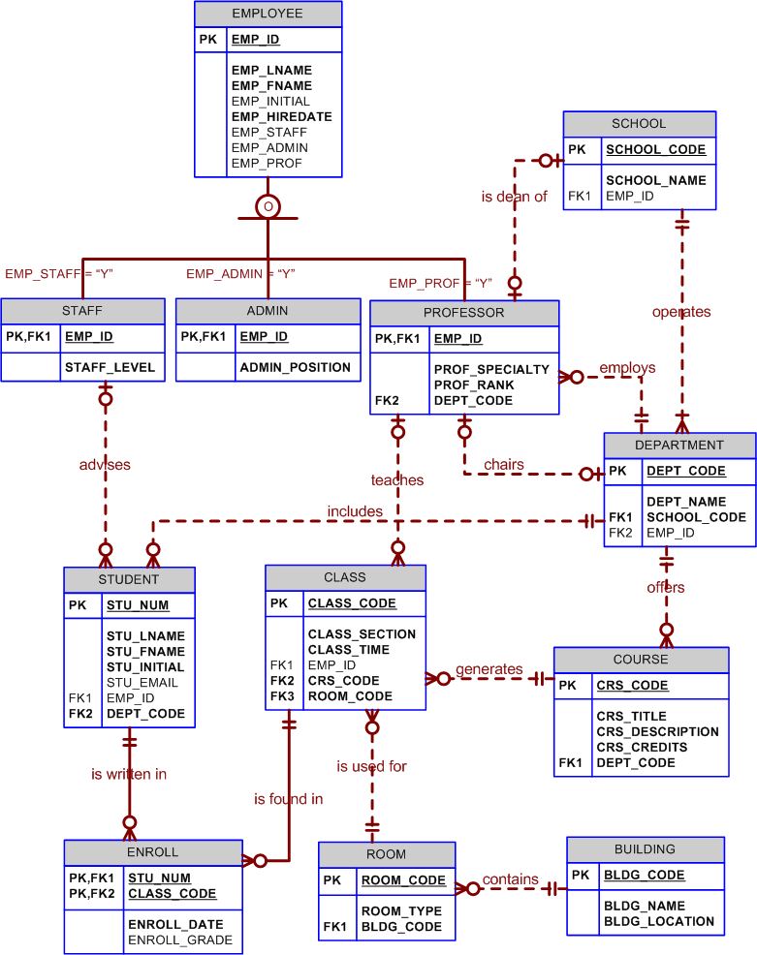

Slide 75
Portion of Tiny College ERD

Slide 76
Tiny College - New Requirement
Tiny College wants to keep track of the history of all administrative appointments (date of appointment and date of termination).
The Tiny College chancellor may want to know how many deans worked in the College of Business between January 1, 1960 and January 1, 2010 or who the dean of the College of Education was in 1990. Given that information, create the complete ERD containing all primary keys, foreign keys, and main attributes.

Slide 77
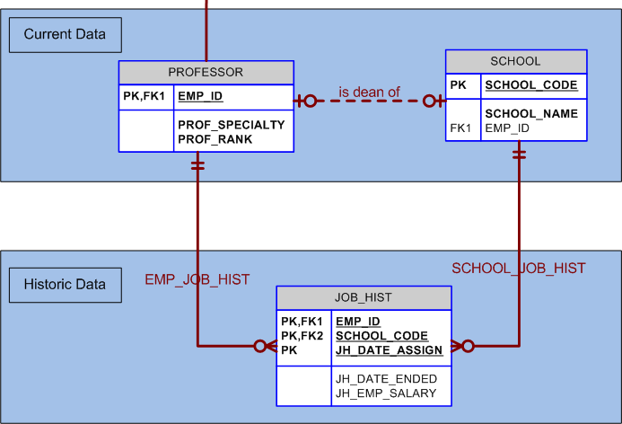
Tiny College ERD

